Slide 1

INTRODUCTION TO STATISTICS
"Some people hate the very name of statistics but I find them full
of beauty and interest.”
(FRANCIS GALTON)
PREPARED BY : NOR SAMSUHADA AHMAD

Slide 2
LEARNING OUTCOMES
By the end of the topic, students should be able to :
To define the types of statistics
To understand the types of variables
To apply frequency distribution

Slide 3
TABLE OF CONTENTS
1.1 Why study statistics
1.2 Definition of Statistics
1.3 Types of statistics
1.4 Basic Statistical Terms
1.5 Types of Variables
1.6 Level of Measurement (Variables Scale)
1.7 Sources of Data
1.8 Data Presentation
1.8.1 Data Presentation for Qualitative Data
1.8.2 Data Presentation for Quantitative Data

Slide 4


1.1 Why study statistics
Data are everywhere
E.g : Business,medical..
Statistical techniques are used to make many decisions that affect our lives

Slide 5
1.2 Definition of Statistics
STATISTICS
Draw conclusion
Simplifying
Collecting
Describing
Science of…

Slide 6
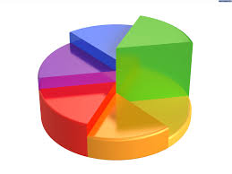
1.3 Types of statistics
Descriptive statistics
Inferential statistics
Method of collecting, summarizing, and presenting data in a convenient and informative way
1. Graphical technique
2. Numerical technique
Methods used to determine something about a population on the basis of a sample
Focus on technique to draw conclusion about pop. Based on sample

Slide 7
1.3.1 Population, Sample,Parameter & Statistic
POPULATION - Entire group to be studied
SAMPLE – A part of the population
Take some part of the population by using an appropriate sampling technique
PARAMETER – Measure characteristics of the population
E.g. µ ,σ² , σ
STATISTIC - Measure characteristics of the sample
E.g.

Slide 8
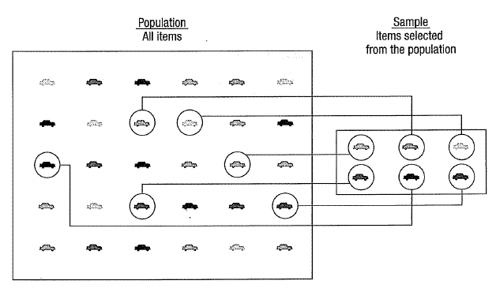
1.3.2 Example of population and sample

Slide 9
1.4 Basic Statistical Terms
ELEMENT
( EXPERIMENTAL UNIT)
Objects either people or thing on which measurement is taken
CENSUS
Conducted to measure a variable for every item in the population of interest.
SAMPLE SURVEY
A study involves a subgroup or sample of a population

Slide 10
1.4 Basic Statistical Terms (cont.)
VARIABLES
Measures the characteristics of the population that the researcher wants to study
DATA
Measure on a variables of interest obtained from a sample

Slide 11
1.4 Basic Statistical Terms (cont.)
PARAMETER
A summary measures for the entire population
STATISTIC
A summary measures for a sample

Slide 12
1.4 Basic Statistical Terms (cont.)
SAMPLING FRAME
A list of all population members
PILOT STUDY
Conducted on a small number of respondents before the actual survey is done.
-improve questionnaire

Slide 13
-The characteristics of the population of interest
-e.g. : Age, gender, monthly income
-Measured on numerical scale
-Yields numerical response
-e.g. :how tall are you?
-Numerical response from counting process
-e.g. : how many children do you have?
-Numerical response from measuring process
-e-.g. :how tall are you?
:what is your weight?
-Measured with non- numerical scale
-Yields categorical response
-e.g.: are you a Malaysian?
1.5 Types of Variables
DISCRETE
QUANTITATIVE/NUMERICAL
VARIABLE
CONTINUOUS
QUALITATIVE/ATTRIBUTE

Slide 14
1.6 Level of Measurement ( Variables Scale)
NOMINAL
-For Identification or Categories
-E.g.: place of birth, hair color
-Non - numeric measurement
ORDINAL
-For Order or Ranking
-E.g: level of education, job satisfaction level
-Non - numeric measurement

Slide 15
1.6 Level of Measurement ( Variables Scale)
(cont.)
INTERVAL
-Measure the difference or distance.
-The difference between data values are meaningful but cannot be manipulated with multiplication and division.
-E.g.: temperature and time
-Numeric measurement
RATIO
-Starting point cannot be negative value
-E.g: body weight and income
-Numeric measurement

Slide 16





1.7 Sources of Data
Data
Measure on the variables of interest obtained from a sample
Primary data
Secondary data

Slide 17
1.7.1 Primary Data
Information obtained first hand by researcher on the variable of interest for the specific purpose of the study
E.g. :A researcher interview the respondents and record their responses
Advantages: more accurate and consistent
Disadvantages: more time, manpower, and higher cost

Slide 18
1.7.2 Secondary Data
Information gathered from sources that already exist
E.g. :data from Bank Negara, Department of Statistics, journal
Advantages: easily accessible, inexpensive
Disadvantages: may lack accuracy, may be biased

Slide 19
1.8 Data Presentation
Data presentation is an essential step before further statistical analysis is carried out
Some common data presentations include frequency table, bar chart, pie chart, pictograph, histogram, ogive, stem-and-leaf plot and box plot
Data can be more easily to read, see and compare

Slide 20
1.8.1 Organizing and Graphing Qualitative (Ungroup) Data
Contingency Table
Frequency Distributions
Charts And Diagrams
Simple Bar Chart
Multiple (Compound) Bar Chart
Component Bar Chart
Percentage Component Bar Chart
Pie Chart

Slide 21
1. Contingency Table
A contingency table also known as a cross-tabulation table
Example: The contingency table below shows the number of students in a college according to their study plan.
Gender | Diploma | Degree | TOTAL
Male | 2050 | 400 | 2450
Female | 3960 | 850 | 4810
TOTAL | 6010 | 1250 | 7260
1
It is to examine the categorical responses in terms of two qualitative variables simultaneously
2
There must be total row and total column
3
HOW TO READ??
For example, there are 850 female of degree students

Slide 22
Exercise 1
A survey of 500 commuters is conducted to know preference towards a new traffic system. From 500 commuters, 200 are males. The result shows that 50% of the male commuters preferred the new system and 45% preferred the old system. Majority of the female commuters (75%) preferred the new system and only 2% of them do not have any preference. Develop a contingency table to summarize the above information.

Slide 23
2. Frequency Distribution
A frequency distribution for qualitative data lists all categories and the number of elements that belong to each of the categories
EXAMPLE:
The grades of 30 students for the Statistics paper are given as follows:
B B C A A A B A B A
A A B A B B B A A C
C B A A B C C A A A
Construct a frequency distribution of the data
Grade | Frequency
A | 15
B | 10
C | 5
Total | 30

Slide 24
2.1 Relative Frequency Distribution
Relative frequency of a category
= Frequency of that Categories Sum of all Frequency
2.2 Relative Percentage Distribution
Relative Percentage
= Relative frequency x 100%
Grade | Frequency | Relative frequency | Relative percentage
A | 15 | 15/30=0.5 | 50%
B | 10 | 10/30=0.33 | 33%
C | 5 | 5/30=0.17 | 17%
Total | 30 | 1 | 100%

Slide 25
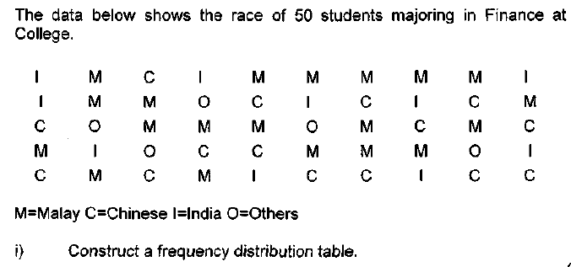
Exercise 2

Slide 26
3. Charts and Diagram
Simple Bar Chart
Multiple Bar Chart
Component Bar Chart
Percentage Component Bar Chart
Pie Chart

Slide 27
a. Simple Bar Chart
*A bar chart is used to display qualitative data contained in the contingency tables or frequency distribution. Characteristics of bar chart are as follows:
The bars are drawn where the length is proportional to the magnitude of the frequency to be represented.
The different categories of the data can be presented along horizontal or vertical axis whichever is appropriate.
Bars are separated; the gap between each bar is uniform and all the bars should be of the same width
Suitable scale must be chosen and it must start at zero
Should have title or heading to indicate the variable that is being presented.

Slide 28
a. Simple Bar Chart (Cont.)
SUITABLE FOR PRESENTING ONLY ONE VARIABLE. IT IS A CHART THAT CONSISTS OF A SET OF NON-JOINING BARS.
Example: The following information relates to the annual profits of AZ Sdn. Bhd. Construct a simple bar chart to represent the data.
Year | 2000 | 2001 | 2002 | 2003 | 2004 | 2005
Sales (RM ‘000) | 2500 | 3600 | 4800 | 5000 | 5400 | 6000
Title
A SIMPLE BAR CHART for the above data
Label of y-axis
Each interval represents
RM 2,000,000 profits
Label of x-axis

Slide 29
b. Multiple Bar Chart
-USEFUL WHEN TWO OR MORE VARIABLES NEED TO BE PRESENTED.
-BARS ARE GROUPED OR JOINED TOGETHER TO REPRESENT A CLASS.
-BARS ALWAYS ARRANGED IN SAME SEQUENCE
-SETS OF BARS FOR EACH CLASS SHOULD BE SEPARATED FOR MULTIPLE COMPARISON
Example: The table shows the enrollment of students in
Uni X according semester. Present the data using
suitable chart and give comment.
SEMESTER/ GENDER | Dis07-Apr08 | Jul08 -Nov08 | Dis08- Apr09 | Jul09 -Nov09 | Dis09-Apr10 | Jul10-Nov10
MALE | 1800 | 2100 | 2000 | 2350 | 2200 | 2500
FEMALE | 2600 | 3050 | 2700 | 3500 | 3000 | 3800
A MULTIPLE BAR CHART for the above data
Title
Label of
y-axis
Legend/key
Label of x-axis

Slide 30
ILLUSTRATES THE COMPONENTS THAT MAKE UP A TOTAL OR AS A WHOLE
EACH COMPONENT IS REPRESENTED BY A SECTION PROPORTIONAL IN SIZE TO ITS REPRESENTATION IN THE TOTAL OF EACH BAR
THE COMPONENT ARE ALWAYS STACKED IN THE SAME ORDER WITHIN EACH BAR
c. Component Bar Chart
The table represents the number of respondents according to the type of English newspaper preferred. Present this information using component bar chart and percentage component bar chart.
Ethnic Group | Type of English Newspaper |  |  | TOTAL
 | NST | Star | Malay Mail
Chinese | 250 | 200 | 50 | 500
Malay | 150 | 50 | 100 | 300
Indian | 100 | 50 | 40 | 180
Others | 10 | 10 | 0 | 20

Slide 31
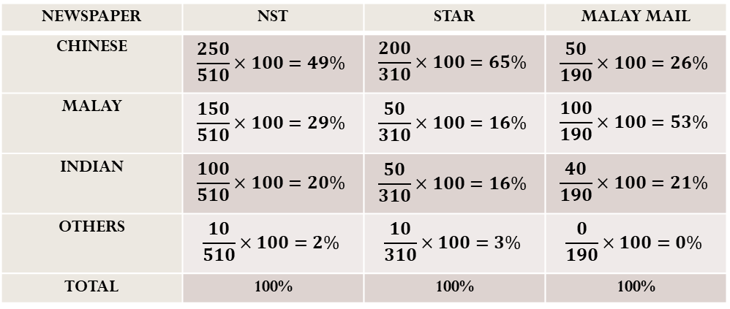
d. Percentage Component Bar Chart
MODIFICATION OF CBC WHERE EACH COMPONENT OF THE TOTAL IS EXPRESSED AS A PERCENTAGE OF THE TOTAL
THE SCALE WILL BE IN PERCENTAGE SCALE, AND ALL BARS DRAWN WILL BE OF THE SAME HEIGHT, REPRESENTING 100% (OF THE TOTAL).
IF THE DATA ARE NOT IN PERCENTAGE FORM, IT IS NECESSARY TO COMPUTE THE PERCENTAGE OF THE TOTAL FOR EACH COMPONENT AND DETERMINE THE CUMULATIVE PERCENTAGES FOR EACH BAR TO FACILITATE THE PLOTTING OF THE POINTS
Ethnic Group | Type of English Newspaper
 | NST | Star | Malay Mail
Chinese | 250 | 200 | 50
Malay | 150 | 50 | 100
Indian | 100 | 50 | 40
Others | 10 | 10 | 0
TOTAL | 510 | 310 | 190
NEWSPAPER | NST | STAR | MALAY MAIL
CHINESE | $$\frac{250}{510}×100=49\%$$ | $$\frac{200}{310}×100=65\%$$ | $$\frac{50}{190}×100=26\%$$
MALAY | $$\frac{150}{510}×100=29\%$$ | $$\frac{50}{310}×100=16\%$$ | $$\frac{100}{190}×100=53\%$$
INDIAN | $$\frac{100}{510}×100=20\%$$ | $$\frac{50}{310}×100=16\%$$ | $$\frac{40}{190}×100=21\%$$
OTHERS | $$\frac{10}{510}×100=2\%$$ | $$\frac{10}{310}×100=3\%$$ | $$\frac{0}{190}×100=0\%$$
TOTAL | 100% | 100% | 100%

Slide 32
d. Percentage Component Bar Chart (Cont.)

Slide 33
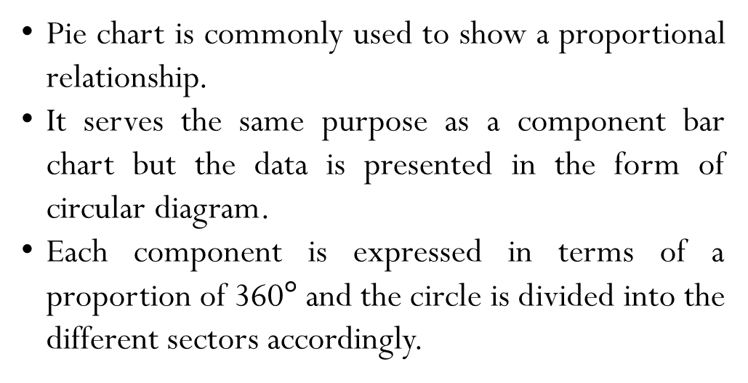
e. Pie Chart
Pie chart is commonly used to show a proportional relationship.
It serves the same purpose as a component bar chart but the data is presented in the form of circular diagram.
Each component is expressed in terms of a proportion of 360$°$ and the circle is divided into the different sectors accordingly.

Slide 34
e. Pie Chart (cont.)
The table below provides information on the total export (in million tons) of Malaysian Rubber based on grade for the year 1989.
RUBBER GRADE | TOTAL EXPORT
 | (million tons)
SMR | 907.07
RSS | 267.66
Latex | 237.92
Other Grades | 74.35
TOTAL | 1487
Source: National Revenues Series, 1995
Construct a pie chart to represent the above information and give your comment.

Slide 35
e. Pie Chart (cont.)
STEP 1 & 2
Express each type of rubber grade as a proportion of 360⁰ and 100%.
RUBBER GRADE | TOTAL EXPORT | Proportion of | Percentage
 | (million tons) | 360⁰
SMR | 907.07 | 219.6⁰ | 61%
RSS | 267.66 | 64.8⁰ | 18%
Latex | 237.92 | 57.6⁰ | 16%
Other Grades | 74.35 | 18⁰ | 5%
TOTAL | 1487 | 360⁰ | 100%
STEP 3

Slide 36
1.8.2 Organizing and Graphing Quantitative (Group) Data
Frequency Distributions for Grouped Data
Graphs
Histogram
Frequency Polygon
Cumulative Frequency Polygon (Ogive)
Stem and Leaf

Slide 37
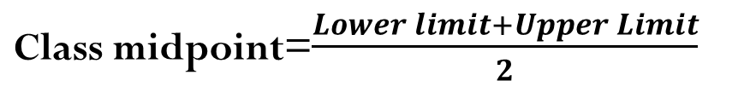
A frequency distribution for a quantitative data lists all the classes and the number of values that belong to each class. Data represented in the form of a frequency distribution are called grouped data.
1. Frequency Distribution
Class boundaries
The class boundary is given by the midpoint between upper limit of one class and the lower limit of the next class.
Class width
Class width = Upper boundary – Lower boundary
Class Midpoint or Class Mark
Class midpoint=$\frac{Lower limit+Upper Limit}{2}$

Slide 38
Characteristics of a Grouped Frequency Distribution
Class Interval | Class Frequencies | Class Boundaries | Class Width | Class Midpoint
5 - 8 | 3 | 4.5 - 8.5 | 4 | 6.5
9 - 12 | 6 | 8.5 - 12.5 | 4 | 10.5
13 - 16 | 9 | 12.5 - 16.5 | 4 | 14.5
17 - 20 | 5 | 16.5 - 20.5 | 4 | 18.5
TABLE 1
Lower class limit
Upper class limit
First class midpoint =
Second class midpoint =
Third class midpoint =
Forth class midpoint =
Lower class boundary
Upper class boundary
Lower class boundary = (-0.5 lower class limit)
Upper class boundary = (+0.5 upper class limit)
Class width of first class = (9-5=4) @ (8.5-4.5=4)
Class width of second class = (13-9=4) @ (12.5-8.5=4)
Class width of third class = (17-13=4) @ (16.5-12.5=4)
Class width of forth class = (21-17=4) @ (20.5-16.5=4)

Slide 39
Characteristics of a Grouped Frequency Distribution
Class Interval | Class Frequencies | Class Boundaries | Class Width | Class Midpoint
3 less than 7 | 4 | 3 – 7 | 4 | 5
7 less than 11 | 6 | 7 – 11 | 4 | 9
11 less than 17 | 9 | 11 – 17 | 6 | 14
17 less than 22 | 3 | 17 - 22 | 5 | 19
TABLE 2
Lower class limit
Upper class limit
Lower class boundary
Upper class boundary
Lower class boundary = Lower class limit
Upper class boundary = Upper class limit
Class width and class midpoint can be obtained by using the same method as in Table 1

Slide 40
PROCEDURE FOR CONSTRUCTING A GROUPED FREQUENCY DISTRIBUTION
Construct a frequency distribution from the scores of a particular statistics test by 40 students
54 | 38 | 50 | 76 | 39 | 67 | 51 | 43 | 44 | 47
83 | 65 | 84 | 92 | 77 | 45 | 57 | 56 | 66 | 68
55 | 59 | 37 | 75 | 74 | 62 | 57 | 53 | 58 | 60
68 | 73 | 64 | 84 | 70 | 54 | 53 | 61 | 70 | 55

Slide 41
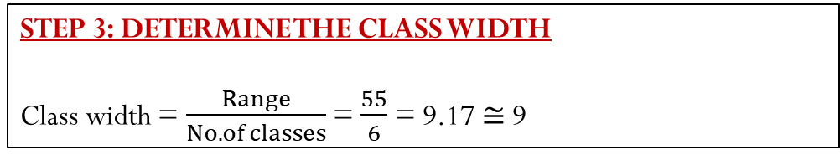
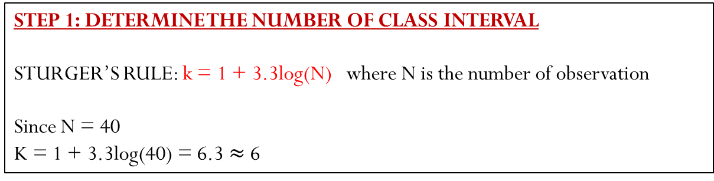
STEP 1: DETERMINE THE NUMBER OF CLASS INTERVAL
STURGER’S RULE: k = 1 + 3.3log(N) where N is the number of observation
Since N = 40
K = 1 + 3.3log(40) = 6.3 $≈$ 6
STEP 2: DETERMINE THE RANGE
Range = maximum value – minimum value
Range = 92 – 37 = 55
STEP 3: DETERMINE THE CLASS WIDTH
Class width = $\frac{Range}{No.of classes}$ = $\frac{55}{6}$ = 9.17 $≅$ 9

Slide 42
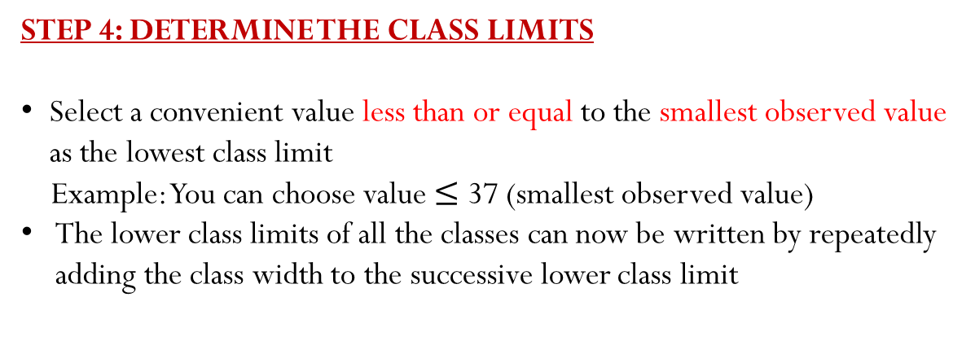
STEP 4: DETERMINE THE CLASS LIMITS
Select a convenient value less than or equal to the smallest observed value as the lowest class limit
Example: You can choose value $≤$ 37 (smallest observed value)
The lower class limits of all the classes can now be written by repeatedly adding the class width to the successive lower class limit
TEST SCORES | NO.OF STUDENTS | CLASS BOUNDARIES | CLASS WIDTH | CLASS MIDPOINT
35-43 | 4 | 34.5-43.5 | 9 | 39
44-52 | 5 | 43.5-52.5 | 9 | 48
53-61 | 13 | 52.5-61.5 | 9 | 57
62-70 | 9 | 61.5-70.5 | 9 | 66
71-79 | 5 | 70.5-79.5 | 9 | 75
80-88 | 3 | 79.5-88.5 | 9 | 84
89-97 | 1 | 88.5-97.5 | 9 | 93
Even though the formula says that the number of classes is 6, we can add another class interval so that no observations are left out. Remember the rule is just for a guide!!!!

Slide 43
STEP 5: DETERMINE THE CLASS FREQUENCIES
Construct a frequency distribution from the scores of a particular statistics test by 40 students
54 | 38 | 50 | 76 | 39 | 67 | 51 | 43 | 44 | 47
83 | 65 | 84 | 92 | 77 | 45 | 57 | 56 | 66 | 68
55 | 59 | 37 | 75 | 74 | 62 | 57 | 53 | 58 | 60
68 | 73 | 64 | 84 | 70 | 54 | 53 | 61 | 70 | 55
35-43
71-79
44-52
80-88
53-61
89-97
62-70

Slide 44
RELATIVE FREQUENCY DISTRIBUTION
The class frequencies can be expressed as a fraction (fractional, decimal or percentage form) of the total number of observations.
TEST SCORE | NO.OF STUDENTS | CLASS BOUNDARIES | CLASS WIDTH | CLASS MIDPOINT
35-43 | 4 | 34.5-43.5 | 9 | 39
44-52 | 5 | 43.5-52.5 | 9 | 48
53-61 | 13 | 52.5-61.5 | 9 | 57
62-70 | 9 | 61.5-70.5 | 9 | 66
71-79 | 5 | 70.5-79.5 | 9 | 75
80-88 | 3 | 79.5-88.5 | 9 | 84
89-97 | 1 | 88.5-97.5 | 9 | 93

Slide 45
RELATIVE FREQUENCY DISTRIBUTION (cont.)
RELATIVE FREQUENCIES
TEST SCORE | NO.OF STUDENTS | FRACTION | DECIMAL | PERCENT
35-43 | 4 | 1/10 | 0.100 | 10%
44-52 | 5 | 1/8 | 0.125 | 12.5%
53-61 | 13 | 13/40 | 0.325 | 32.5%
62-70 | 9 | 9/40 | 0.225 | 22.5%
71-79 | 5 | 1/8 | 0.125 | 12.5%
80-88 | 3 | 3/40 | 0.075 | 7.5%
89-97 | 1 | 1/40 | 0.025 | 2.5%
Total | 40 | 40/40 | 1.000 | 100%

Slide 46
CUMULATIVE FREQUENCY DISTRIBUTION
A cumulative frequency distribution shows a running total of the frequencies in the distribution. Less than upper boundaries, cumulative frequencies, cumulative relative frequencies
TEST SCORE | NO.OF STUDENTS | CLASS BOUNDARIES | CLASS WIDTH | CLASS MIDPOINT
35-43 | 4 | 34.5-43.5 | 9 | 39
44-52 | 5 | 43.5-52.5 | 9 | 48
53-61 | 13 | 52.5-61.5 | 9 | 57
62-70 | 9 | 61.5-70.5 | 9 | 66
71-79 | 5 | 70.5-79.5 | 9 | 75
80-88 | 3 | 79.5-88.5 | 9 | 84
89-97 | 1 | 88.5-97.5 | 9 | 93

Slide 47
CUMULATIVE FREQUENCY DISTRIBUTION (cont.)
Always start with 0
LESS THAN UPPER BOUNDARIES | CUMULATIVE FREQUENCIES | CUMULATIVE RELATIVE FREQUENCIES
34.5 | 0 | 0
43.5 | 4 | 4/40 = 10.0%
52.5 | 9 | 9/40 = 22.5%
61.5 | 22 | 22/40 = 55.0%
70.5 | 31 | 31/40 = 77.5%
79.5 | 36 | 36/40 = 90.0%
88.5 | 39 | 39/40 = 97.5%
97.5 | 40 | 40/40 = 100.0%

Slide 48
2. Graphs
Histogram
Frequency Polygon
Cumulative Frequency Polygon (Ogive)
Stem and Leaf

Slide 49
a. Histogram
A vertical bar chart of the data in a frequency distribution is called a histogram.
In a histogram there are no gaps between adjacent bars.
The class boundaries are shown on the horizontal axis.
The vertical axis is either frequency, relative frequency, or percentage.
The height of the bars represent the frequency, relative frequency, or percentage.
Useful when there are two or more groups to compare.

Slide 50
5.0 10.0 15.0 20.0 25.0 30.0 35.0

Slide 51
b. Frequency Polygon
Can be obtained from histogram
Joining the midpoints on the top of each bar of a histogram will convert the histogram into a frequency polygon
In order to ensure that the tail at each end of the distribution touches the horizontal x-axis, one extra class at each end should be added.
A frequency polygon is formed by having the midpoint of each class represent the data in that class and then connecting the sequence of midpoints at their respective class frequency.
Useful when there are two or more groups to compare.

Slide 52
5.0 10.0 15.0 20.0 25.0 30.0 35.0

Slide 53
c. Cumulative Frequency Polygon (Ogive)
An ogive is a graph of a cumulative distribution.
The data values are shown on the horizontal axis.
Shown on the vertical axis are the:
cumulative frequencies, or
cumulative relative frequencies, or
cumulative percent frequencies
The frequency (one of the above) of each class is plotted as a point.
The plotted points are connected by straight lines.

Slide 54
Example:
Construct the less than ogive
Marks (%) | 30-39 | 40-49 | 50-59 | 60-69 | 70-79 | 80-89 | 90-99
No. of students | 2 | 4 | 8 | 14 | 10 | 5 | 1
Always start with 0
Marks (Less than upper boundaries) | Cumulative no. of students
29.5 | 0
39.5 | 2
49.5 | 6
59.5 | 14
69.5 | 28
79.5 | 38
89.5 | 43
99.5 | 44
UPPER CLASS BOUNDARIES – ( x-axis )
OGIVE
CUMULATIVE FREQUENCY – (y-axis )

Slide 55
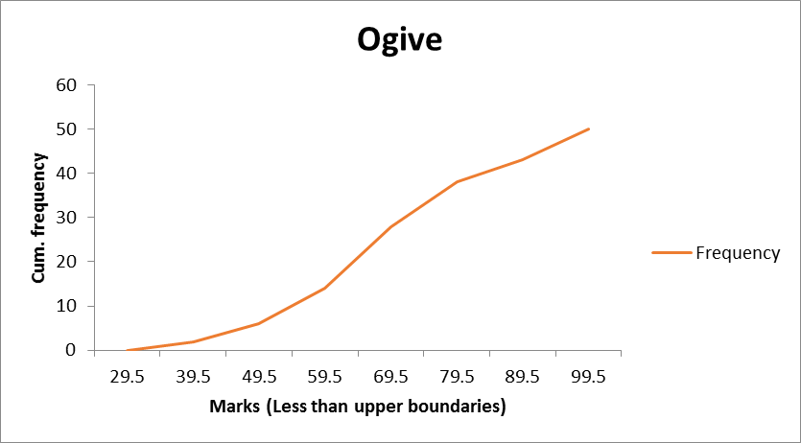

Slide 56
d. Stem and Leaf Display
A stem-and-leaf display organizes data into groups (called stems) so that the values within each group (the leaves) branch out to the right on each row.
Age of College Students
Day Students Night Students
Age of Surveyed College Students | Day Students
 | 16 | 17 | 17 | 18 | 18 | 18
 | 19 | 19 | 20 | 20 | 21 | 22
 | 22 | 25 | 27 | 32 | 38 | 42
 | Night Students
 | 18 | 18 | 19 | 19 | 20 | 21
 | 23 | 28 | 32 | 33 | 41 | 45
Stem | Leaf
1 | 67788899
2 | 0012257
3 | 28
4 | 2
Stem | Leaf
1 | 8899
2 | 0138
3 | 23
4 | 15

Slide 57
Example 2:
The following are the scores of 30 college students on a statistics test.
75 52 80 96 65 79 71 87 93 95
69 72 81 61 76 86 79 68 50 92
83 84 77 64 71 87 72 92 57 98
Construct a stem-and-leaf display for these data.
Solution:
Arrange the data in ascending order
50, 52, 57, 61, 64, 65, 68, 69, 71, 71, 72, 72, 75, 76, 77, 79, 79, 80, 81, 83, 84, 86, 87, 87, 92, 92, 93, 95, 96, 98.
5 | 0 2 7
6 | 1 4 5 8 9
7 | 1 1 2 2 5 6 7 9 9
8 | 0 1 3 4 6 7 7
9 | 2 2 3 5 6 8

Slide 58
Activity 1

Slide 59


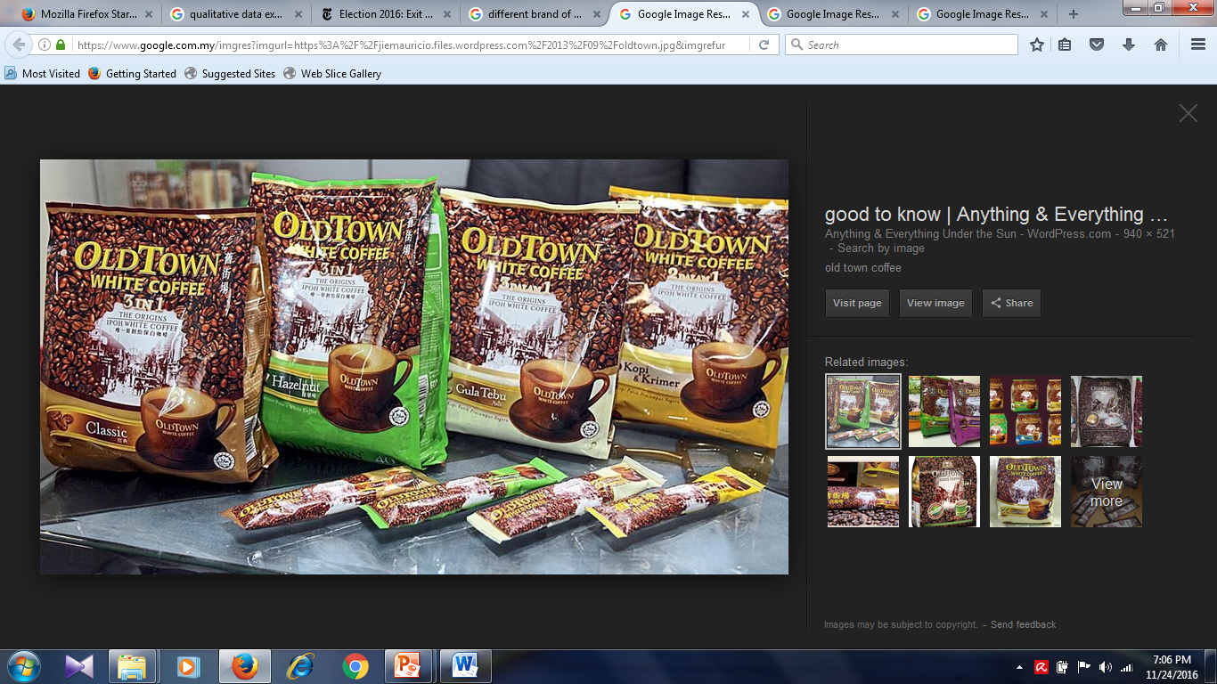
For each of the following variables, classify whether it is qualitative, quantitative discrete or quantitative continuous variable.
Brand of coffees ?
QUALITATIVE

Slide 60

Volume of soft drink ?
QUANTITATIVE CONTINUOUS

Slide 61
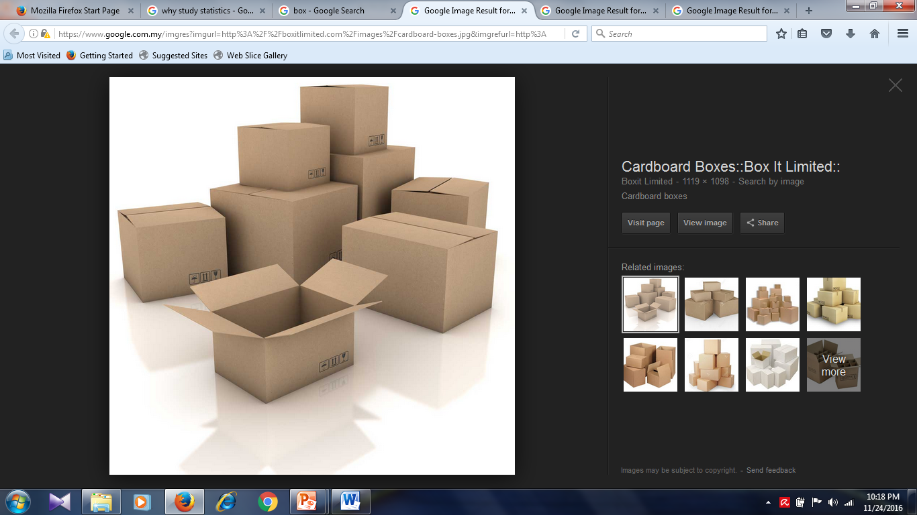
Number of boxes ?
QUANTITATIVE DISCRETE

Slide 62



Favorite vacation spots ?
QUALITATIVE

Slide 63
Activity 2

Slide 64
Listed below are the records for the 50 students who used the main reference text book in the SQQS1013 course in second semester session 2008/2009 and their scores in several assessments.
Keys:
STUD = number of students
TEST1 = score on first test
TEST2 = score on second test
QUIZ = score on the quiz
FINAL = score on final exam
TOTAL = total score for test, quiz and final exam

Slide 65
STUD | TEST1 | TEST2 | QUIZ | FINAL | TOTAL
1 | 30 | 28 | 30 | 80 | 75
2 | 20 | 22 | 45 | 88 | 74
3 | 35 | 39 | 33 | 56 | 72
4 | 16 | 30 | 20 | 70 | 62
5 | 35 | 38 | 23 | 45 | 64
6 | 36 | 20 | 44 | 89 | 81
7 | 25 | 22 | 40 | 89 | 76
8 | 22 | 28 | 33 | 90 | 77
9 | 20 | 26 | 37 | 69 | 65
10 | 20 | 19 | 38 | 70 | 62
11 | 25 | 20 | 39 | 90 | 75
12 | 34 | 28 | 29 | 95 | 84
13 | 36 | 34 | 27 | 77 | 79
14 | 38 | 30 | 35 | 45 | 64
15 | 36 | 29 | 40 | 60 | 71
16 | 22 | 30 | 37 | 30 | 48
17 | 33 | 22 | 39 | 40 | 55
18 | 34 | 33 | 30 | 75 | 77
19 | 35 | 31 | 40 | 76 | 79
20 | 22 | 29 | 35 | 64 | 65
21 | 26 | 27 | 30 | 65 | 65
22 | 39 | 30 | 39 | 90 | 87
23 | 34 | 38 | 40 | 45 | 67
24 | 33 | 30 | 30 | 56 | 66
25 | 25 | 20 | 29 | 59 | 58
STUD | TEST1 | TEST2 | QUIZ | FINAL | TOTAL
26 | 34 | 20 | 33 | 25 | 46
27 | 35 | 29 | 30 | 34 | 55
28 | 36 | 27 | 20 | 45 | 58
29 | 25 | 20 | 30 | 56 | 57
30 | 26 | 22 | 35 | 67 | 65
31 | 29 | 20 | 45 | 78 | 73
32 | 27 | 28 | 31 | 41 | 54
33 | 23 | 20 | 20 | 46 | 49
34 | 24 | 30 | 33 | 58 | 63
35 | 33 | 31 | 39 | 67 | 73
36 | 34 | 26 | 36 | 63 | 69
37 | 37 | 35 | 34 | 59 | 72
38 | 38 | 30 | 28 | 70 | 75
39 | 28 | 29 | 26 | 80 | 74
40 | 27 | 25 | 39 | 90 | 79
41 | 38 | 35 | 40 | 50 | 70
42 | 30 | 25 | 30 | 66 | 67
43 | 31 | 27 | 33 | 63 | 67
44 | 28 | 30 | 30 | 57 | 64
45 | 26 | 30 | 29 | 59 | 63
46 | 31 | 29 | 33 | 80 | 77
47 | 30 | 33 | 30 | 88 | 82
48 | 26 | 30 | 31 | 57 | 63
49 | 25 | 29 | 20 | 56 | 59
50 | 18 | 28 | 29 | 67 | 62

Slide 66
Identify the level of measurement for each variable.
Construct the frequency table for TOTAL score using Sturge’s rule.
Construct a Histogram based on your answer in (b).
If the grade for total is as follows:
A = TOTAL ≥ 85
B = 75 ≤ TOTAL ≤ 84.9
C = 65 ≤ TOTAL ≤ 74.9
D = 60 ≤ TOTAL ≤ 64.9
E = 50 ≤ TOTAL ≤ 59.9
F = TOTAL < 50
Draw a pie chart to show the GRADE score.

Slide 67


Slide 68


